Slide 1
35-y.o. female w/abdominal pain and suspected ureterolithiasis
Philipp Stelzer

Slide 2
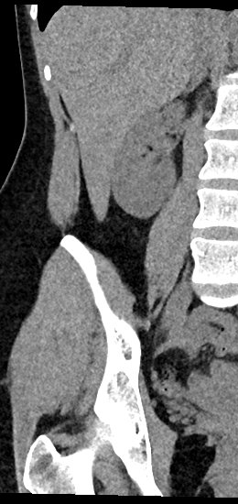
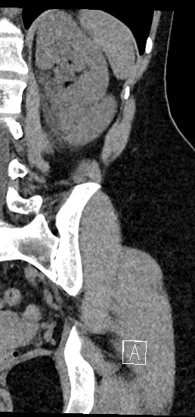
Non-contrast CT scan
No evidence of hydroureteronephrosis

Slide 3
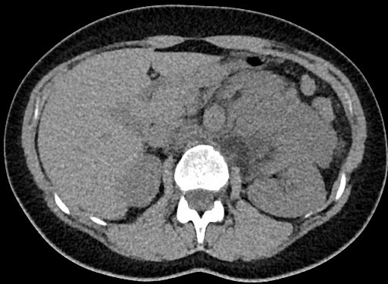
Non-contrast CT scan
Well defined, partially encapsulated, solid soft-tissue mass

Slide 4
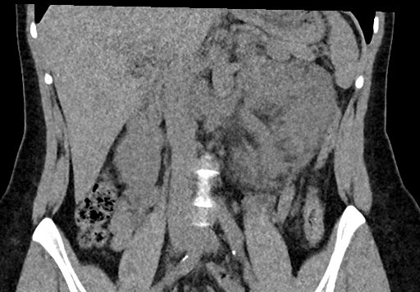
Non-contrast CT scan
Well defined, partially encapsulated, solid soft-tissue mass

Slide 5
Non-contrast CT scan
Fatty components
Dilated left ovarian vein

Slide 6
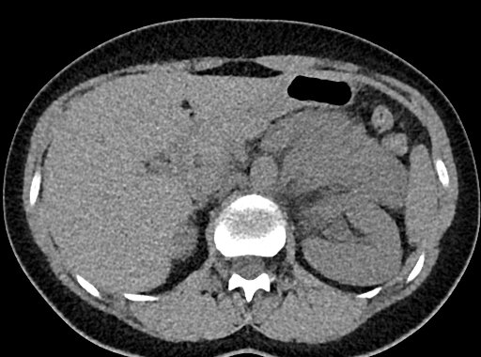
DDx: Paraduodenal Hernia
Left paraduodenal hernia
Courtesy of Dr Ryan Logan Webb,
Radiopaedia.org, rID: 52006
This patient

Slide 7
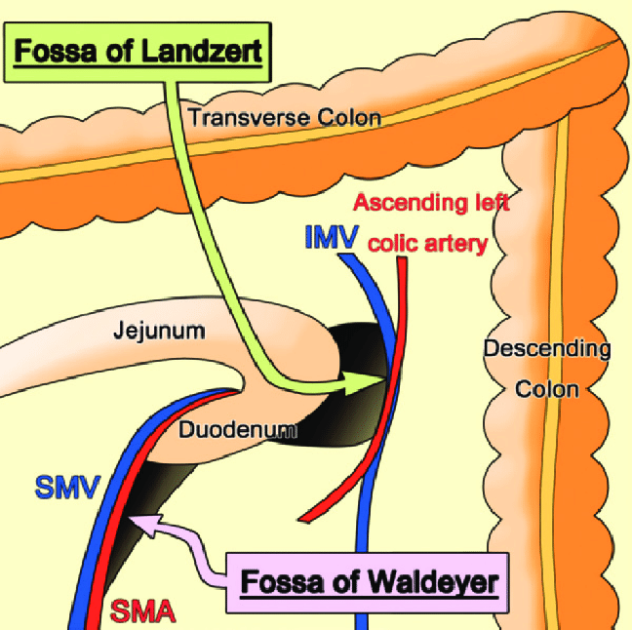
DDx: Paraduodenal Hernia
Left paraduodenal hernia
Case courtesy of Dr Ryan Logan Webb, Radiopaedia.org, rID: 52006
Internal Hernias in the Era of Multidetector CT: Correlation of Imaging and Surgical Findings - Scientific Figure on ResearchGate. Available from: https://www.researchgate.net/figure/Fossa-of-Landzert-and-fossa-of-Waldeyer-The-inferior-mesenteric-vein-IMV-and-ascending_fig2_284279727

Slide 8
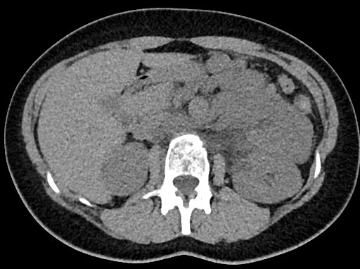
Non-contrast CT scan
Retroaortic components, indicating retroperitoneal localization/origin of mass

Slide 9
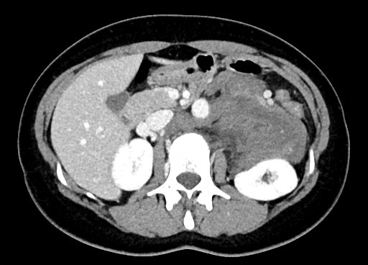
Contrast-enhanced CT scan – PV phase
Minimal, inhomogenous, contrast enhancement
Negative beak sign
Adjacent to several vessels but no apparent infiltration

Slide 10
DDx: Retroperitoneal mass
Infiltrating tumor
Lymphoma
(3) Mesenchymal tumors:
a. Sarcomas: Lipo > Undifferentiated > Leio > Rhabdo >
Fibro
b. Peripheral nerve tumors: Ganglioneuroma,
Ganglioneuroblastoma, Neuroblastoma, MPNST
c. Vascular tumors: Hemangiopericytoma
(4) Extragonadal germ cell tumor
(5) Primary retroperitoneal adenocarcinoma

Slide 11
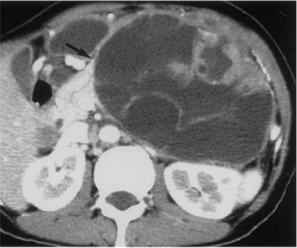
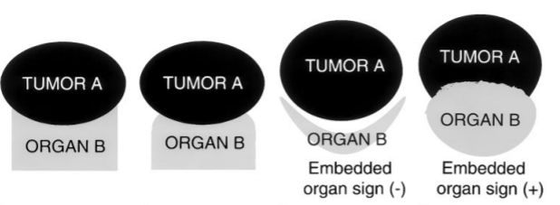
Differentation of retroperitoneal masses
Organ of Origin
Beak-Sign
Phantom Organ Sign
Embedded Organ Sign
Prominent Feeding Artery Sign
Positive beak sign in cystic pancreatic neoplasm

Slide 12
Differentation of retroperitoneal masses
Pattern of spread
Between and around Organs/vessels – Lymphangioma, Lymphoma
Along anatomic structures – Ganglioneuroma, Paragangliomas
Nishino M, Hayakawa K, Minami M, Yamamoto A, Ueda H, Takasu K. Primary retroperitoneal neoplasms: CT and MR imaging findings with anatomic and pathologic diagnostic clues. Radiographics. 2003 Jan-Feb;23(1):45-57. doi: 10.1148/rg.231025037. Erratum in: Radiographics. 2003 Sep-Oct;23(5):1340. PMID: 12533639.

Slide 13
Differentation of retroperitoneal masses
Tumor components
Fat: Liposarcoma (LG > HG), Teratoma
Myxoid stroma: Neurogenic tumors, Sarcoma, Desmoids,…
Necrosis: Leiomyosarcoma, Paraganglioma,..
Cystic: Lymphangioma, mucinous-cystic tumors
Hypervascular: Paraganglioma, Hemangiopericytoma > Sarcoma
Nishino M, Hayakawa K, Minami M, Yamamoto A, Ueda H, Takasu K. Primary retroperitoneal neoplasms: CT and MR imaging findings with anatomic and pathologic diagnostic clues. Radiographics. 2003 Jan-Feb;23(1):45-57. doi: 10.1148/rg.231025037. Erratum in: Radiographics. 2003 Sep-Oct;23(5):1340. PMID: 12533639.

Slide 14
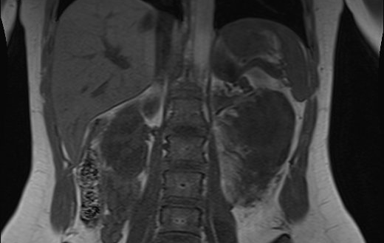
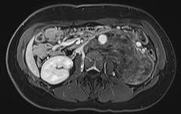
Contrast-enhanced MRI
Homogenous low SI
Heterogenous intermediate-high SI
Fluid/myxoid
Fat
T1 unenhanced
T2
Slight heterogenous enhancement
No diffusion restriction
T1 FS post-contrast
ADC

Slide 15
Summary of findings
Origin: Negative beak sign, no phantom organ sign, no known primary tumor → Primary retroperitoneal mass
Spread pattern: Around vessels/organs, but lymphoma and lymphangioma unlikely (no diffusion-restriction/cystic components) → Spread along not obviously visible anatomic structures?
Components: mostly soft-tissue, little fat and maybe myxoid stroma, no hypervascularisation, no cystic or necrotic components → DDx: Neurogenic tumors, (Lipo)Sarcoma, Desmoids, Teratoma
Large mass w/o apparent organ/vessel infiltration, pathological lymph nodes or distant metastases (Chest CT also negative) → Sarcoma less likely
Next Procedure: Biopsy

Slide 16
Ganglioneuroma
Benign sympathetic nerve tumour composed of ganglion and Schwann cells
Congenital (neural crest) vs de novo (maturing Neuroblastomas and Ganglioneuroblastomas)
Location: 40% paravertebral mediastinum,
40% retroperitoneum, 20% adrenal

Slide 17
Ganglioneuroma
Associated with NF1, MEN 2B und Turner Syndrome
CT: well-defined, solid, encapsulated,
iso/hypodense to muscle
MR: T1 homogenous low-intermediate SI,
T2 heterogeneous intermediate-high SI,
T1 C+ very variable
Therapy: Resection and histologic workup

Slide 18
Take-Home Message
Paraduodenal Hernia
Left: Fossa of Landzert, Right: Fossa of Waldeyer
Relation to IMV/celiac a or SMA/SMV/AMS
Sign of closed-loop obstruction?
Retroperitoneal RF
Organ of origin ?
Pattern of spread?
Tumor components?

